Slide 1







Interacting with Tiny bit
iOS bluetooth APP control
Yahboom

Slide 2







Contents
Download code
Download APP
Connect bluetooth
About APP
Yahboom

Slide 3
Download code
! Note: We provide two hex files,
microbit-Buletooth_control.hex without ultrasonic display function,
The microbit-Bluetooth_control_with_Ultrasonic.hex is shown with an ultrasound display.
It is recommended that you use the former (without ultrasound display, the control is smoother)
Yahboom

Slide 4
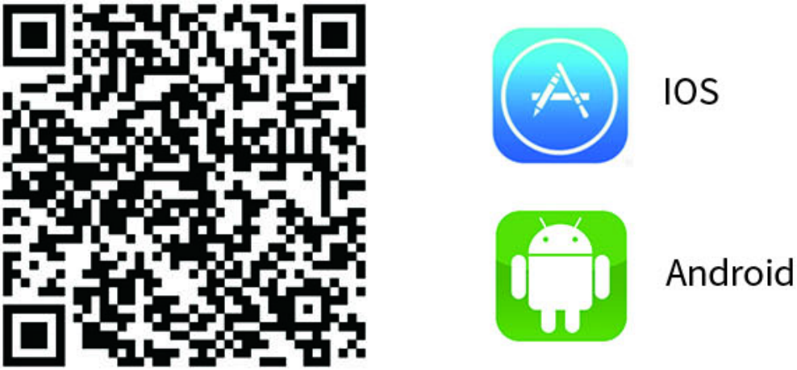
Download code
Apple users should use the camera to scan the QR code to enter the App Store to download and install or search for "Mbit" in the App Store or search for "Yahboom" to find "Mbit".
Yahboom

Slide 5
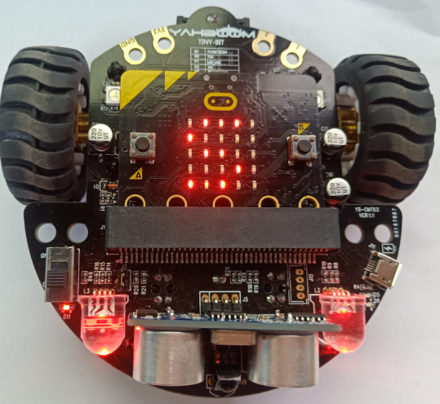
Connect bluetooth
3.1After downloading the Bluetooth remote control APP, we have to install it.
(Note: If the phone prompts you to obtain location rights during installation, you need to click to “agree” to get location permissions.)
3.2After the Bluetooth remote control code is downloaded, open the power of the Tiny-bit. At this point, you will see the pattern shown in Figure 3-1 on the LED dot matrix of the micro:bit board. The RGB light will be lighted up in red. It is the state that Bluetooth is not connected.
Figure 3-1
Yahboom

Slide 6
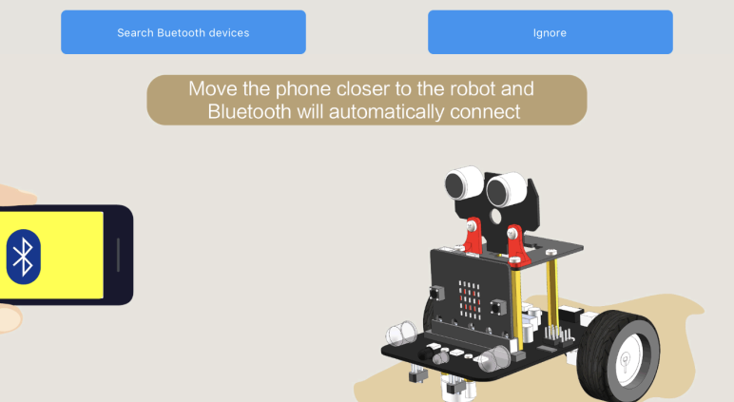
Connect bluetooth
3.3 After the app is installed, you need to turn on the Bluetooth of your iPhone. Then, open the Bluetooth remote control APP as shown in Figure 3-2 and move the phone closer to the robot and Bluetooth will automatically connect.
Figure 3-2
Yahboom

Slide 7
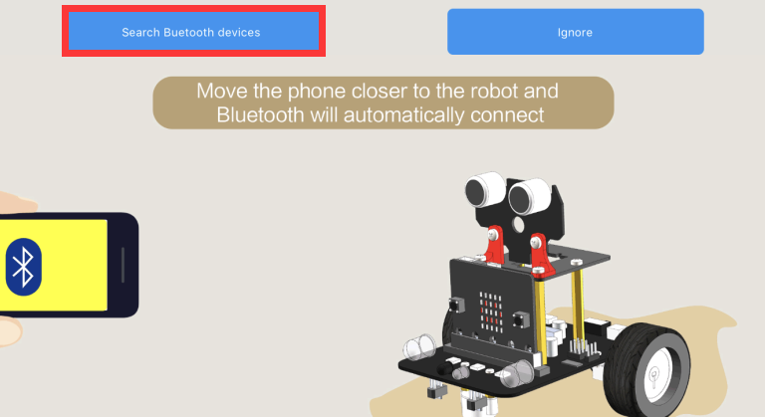
Connect bluetooth
If Bluetooth can't connect automatically, you need to click 【Search Bluetooth devices】 to connect the Bluetooth between the phone and the robot. As shown in Figure 3-3.
Figure 3-3
Yahboom

Slide 8
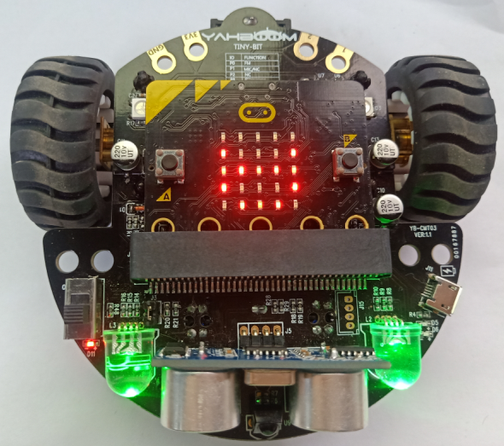
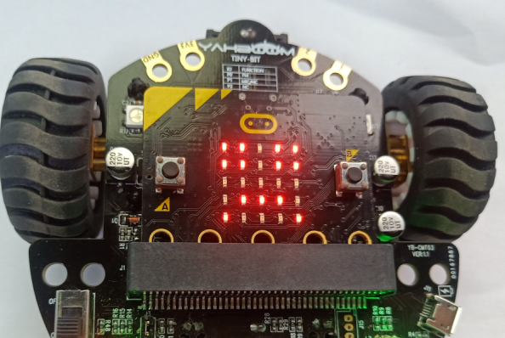
Connect bluetooth
After the Bluetooth is connected successfully, the pattern shown in Figure 3-4 will be displayed on the dot matrix of the Tiny-bit, and then the green RGB light will be illuminated. After waiting for the green RGB searchlight to be lit, we can start controlling the car.
If the Bluetooth is disconnected, a pattern of crying faces will appear on the dot matrix of the Tiny-bit car, as shown in Figure 3-5 below.
Figure 3-4
Figure 3-5
Yahboom

Slide 9
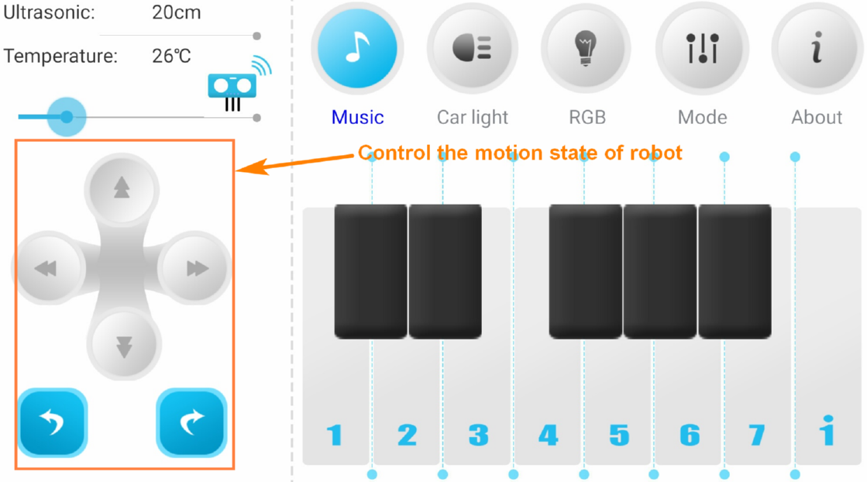
About APP
4. APP interface:
4.1 Basic :
Yahboom

Slide 10
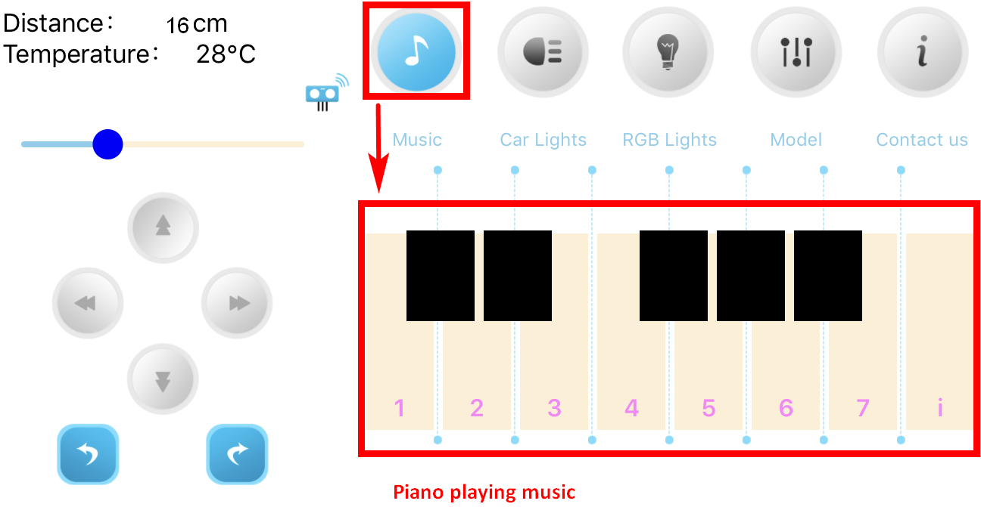
About APP
4.2 Music
Yahboom

Slide 11
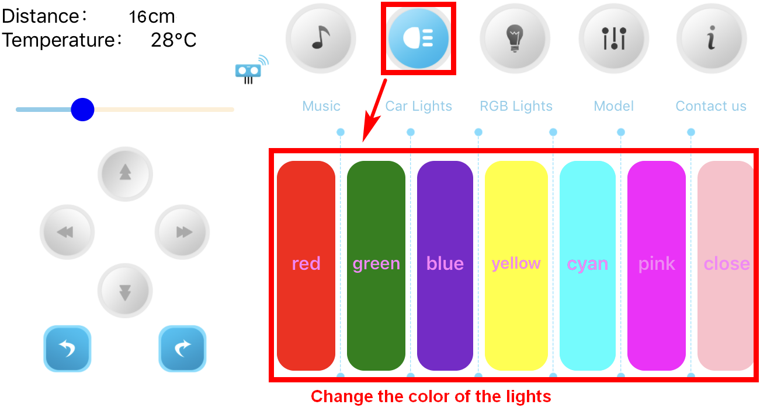
About APP
4.3 Car Lights
Yahboom

Slide 12
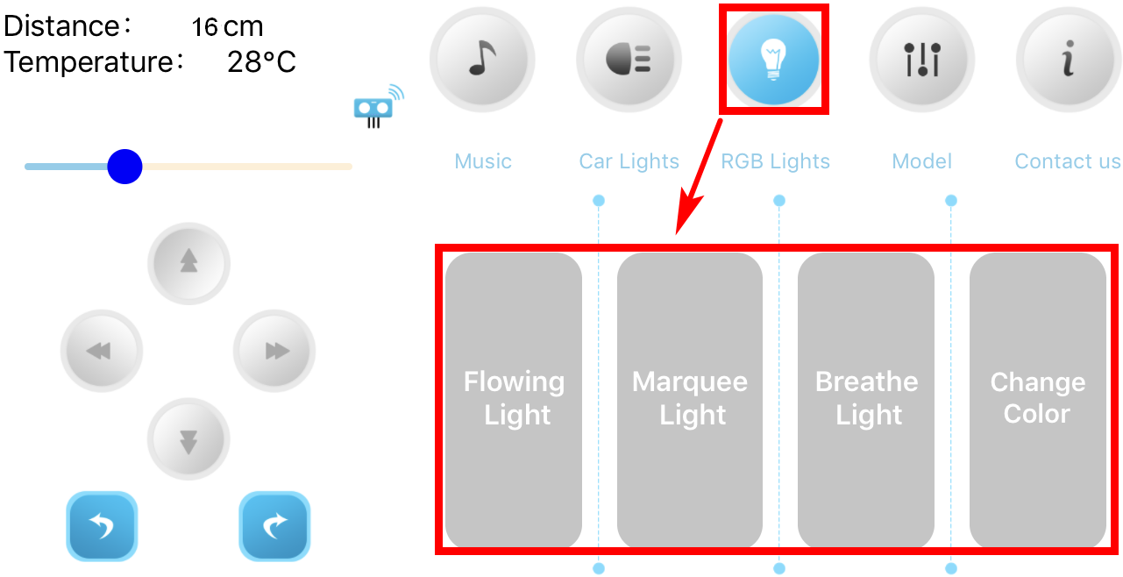
About APP
4.4 RGB Lights
Yahboom

Slide 13
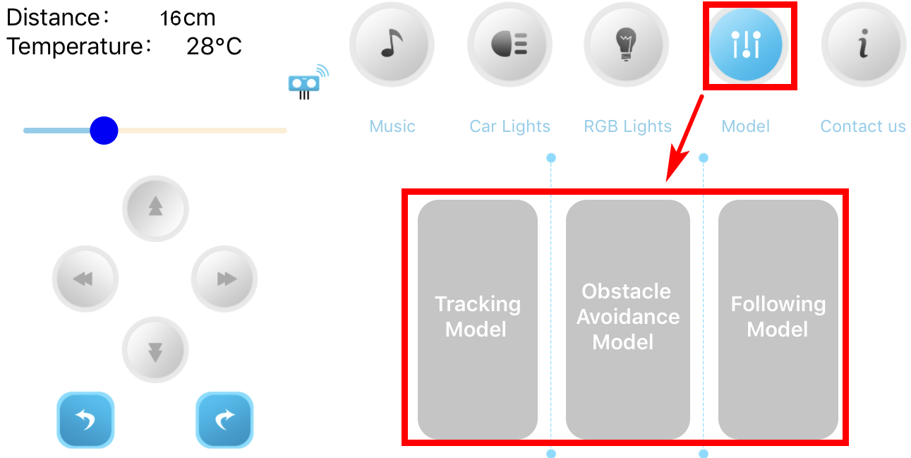
About APP
4.5 Mode
Yahboom

Slide 14
Inspire Creativity Embrace Innovation
Thank you!!!

